Slide 1
Olympics Performance Prediction
Presented By:
Yash Bhargava Rajit Kumar Prajapati Ritik Prakash
(221B456) (221B482) (221B498)
Project Coordinator : Dr. Rahul Pachauri
Project No. : RP4

Slide 2
TABLE OF CONTENTS
TOPIC | SLIDE NO.
Introduction | 3
Requirement Analysis | 4-5
Performance Prediction Workflow | 6
Tools And Technologies Used | 7-8
Models Used | 9
Performance Metrics Used | 10
Expected Outcome | 11
Challenges | 12
Conclusion | 13
References | 14

Slide 3
Introduction
Predicting Olympic performance based on historical data and athlete attributes.
Helps in talent scouting, training plans, and performance enhancement.
Utilizes machine learning models to forecast results.

Slide 4
Requirement Analysis
Historical Olympic data (medals, results, events).
Athlete attributes (age, height, weight, nationality, past performance).
Environmental and external factors (weather, location, competition level).

Slide 5
Requirement Analysis
Athlete demographics (age, height, weight, country).
Previous Olympic records and performance trends.
Sport-specific attributes (e.g., speed, endurance, strength).
Competition factors (opponents, conditions, historical trends).

Slide 6
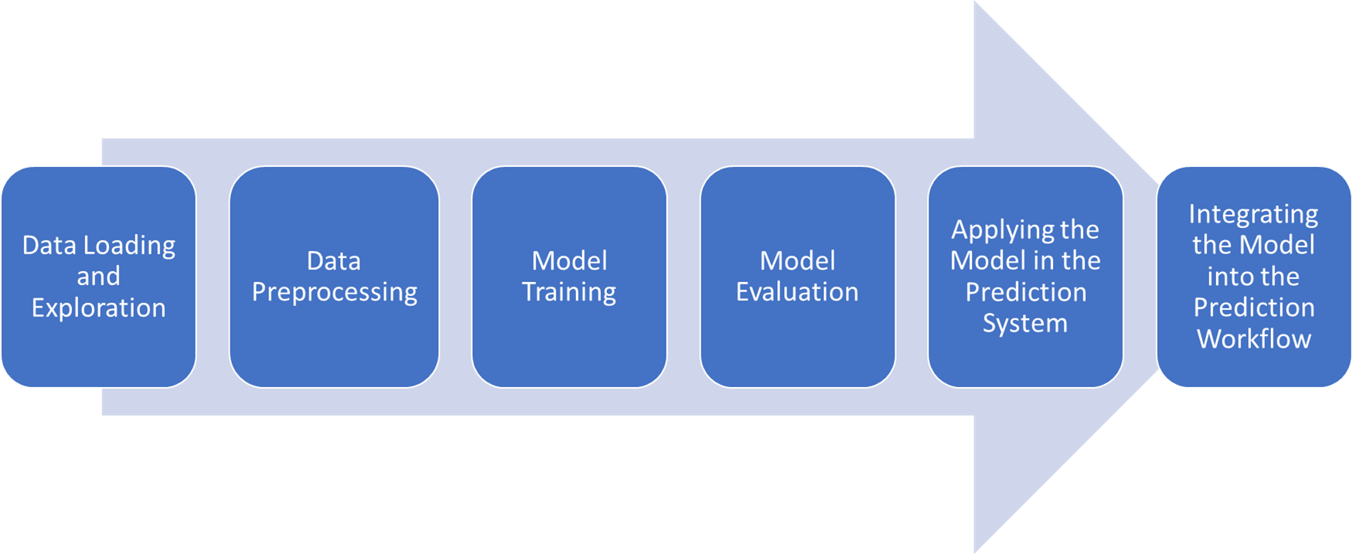
Performance Prediction Workflow

Slide 7
Tools And Technologies Used
Pandas:
  Purpose: Data manipulation and analysis
  Use in Project:Handles data loading and preprocessing (like reading the dataset, creating dummy variables, and manipulating dataframes).
NumPy:
  Purpose: Numerical computation
  Use in Project:Powers numerical operations like array manipulations, which support data structures and computations , also used to converting or reshaping the dataset.

Slide 8
Tools And Technologies Used
Matplotlib:
  Purpose: Visualization
  Use in Project:Used to visualize data through plots or charts , plotting the ensemble machine learning algorithms to understand the precision and recall plot.
Scikit-learn:
  Purpose: Implement and train models
  Use in Project:Used to implement and train the classifier, make predictions, and evaluate model performance (e.g., accuracy).

Slide 9
Models Used
Linear Regression
Logistic Regression
Decision Tree
Random Forest
Gradient Boosting

Slide 10
Performance Metrics Used
Accuracy
Precision
Recall
F1 Score

Slide 11
Expected Outcome
Accurate Medal Predictions
Key Performance Insights
Data Visualization & Trends
Model Evaluation & Accuracy

Slide 12
Challenges
Data availability and quality.
Variability in athlete performance.
External factors influencing results.
Model interpretability and bias issues.

Slide 13
Conclusion
Predicts Olympic performance using historical data and Machine Learning models.
Data-driven insights can enhance training strategies.
Overcoming challenges can improve accuracy and fairness.

Slide 14
References
Tools and libraries : https://towardsdatascience.com/top-5-machine-learning-libraries-in-python-e36e3e0e02af
Infosys course : https://infyspringboard.onwingspan.com/web/en/app/toc/lex_auth_ 013720165067218944334_shared/overview

Slide 15


